Slide 1
Automatic Watering system for plants
Submitted by…,
Induja Sudhish(c0769921)
Group 6

Slide 2
Interfacing of soil moisture sensor with beagle bone black

Slide 3

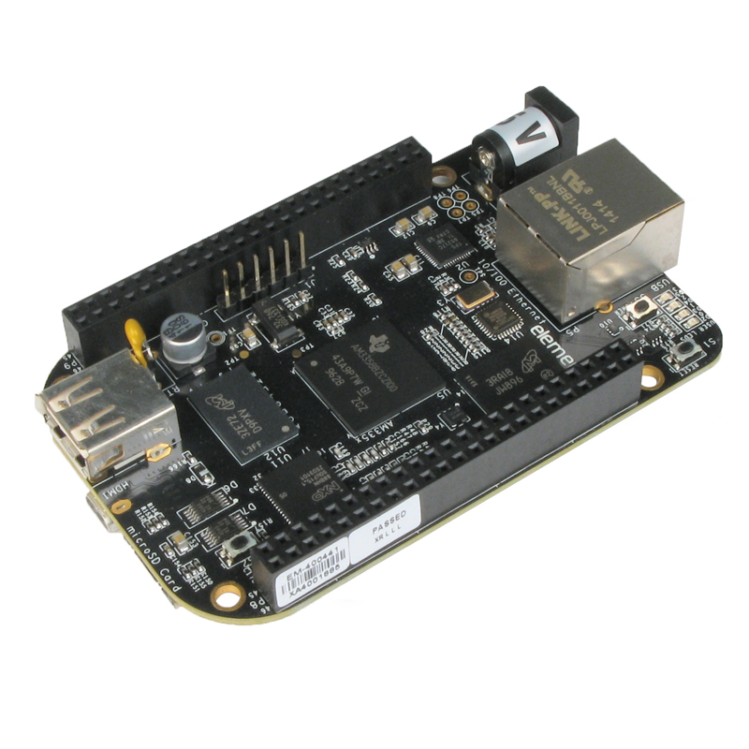
Beaglebone black
It is a low cost, open hardware and expandable computer launched by a community of developers sponsored by Texas instruments.
As the knowledge of users develops, the board provides more complicated interfaces including C/C++ functions to access digital and analog pins aboard the ARM Cortex A8 microprocessor.

Slide 4
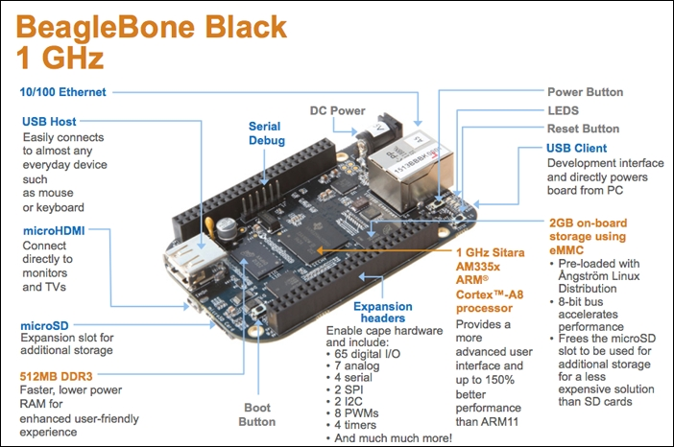

Slide 5
Specifications
Processor AM3358; 1GHz – USB powered or DC powered
Memory :512 MB DDR3 SDRAM; 2GB eMMC Flash
Power options :USB connection, 5 VDC external jack
Board features :HDMI with audio; USB, 10/100 Ethernet; serial debug via external header
Processor Subsystems :176K ROM; 64K RAM;

Slide 7
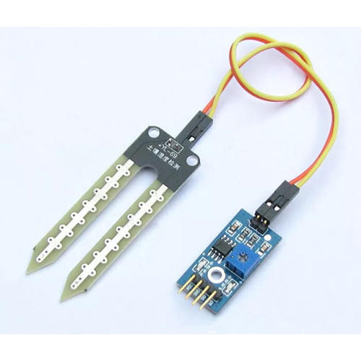
Soil moisture sensor(FC-28)
The soil moisture sensor consists of two probes that are used to measure the volumetric content of water. The two probes allow the current to pass through the soil, which gives the resistance value to measure the moisture value.

Slide 8
Cont….
When there is water, the soil will conduct more electricity, which means that there will be less resistance. Dry soil conducts electricity poorly, so when there is less water, then the soil will conduct less electricity, which means that there will be more resistance.
This sensor can be connected in analog and digital modes

Slide 9
Cont…
The specifications of the FC-28 soil moisture sensor are as follows: Input Voltage: 3.3–5V
Output Voltage: 0–4.2V
Input Current: 35mA
Output Signal: both analog and digital

Slide 10
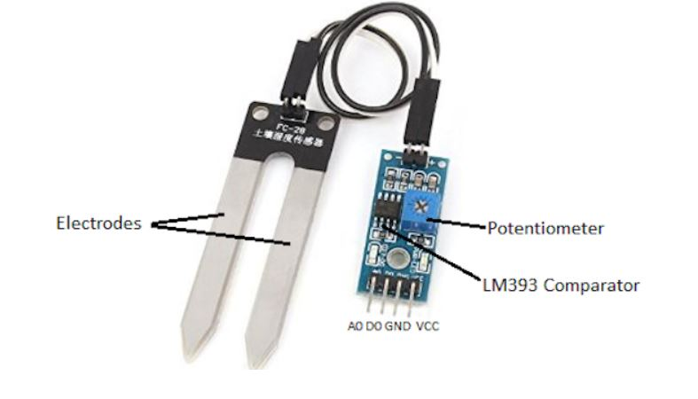
Pin-out
The FC-28 soil moisture sensor has four pins: VCC: Power
A0: Analog Output
D0: Digital Output
GND: Ground

Slide 11
Cont..
The module also contains a potentiometer, which will set the threshold value.
This threshold value will be compared by the LM393 comparator.
The output LED will light up and down according to this threshold value.

Slide 12

Interfacing of FC-28 with BBB

Slide 13
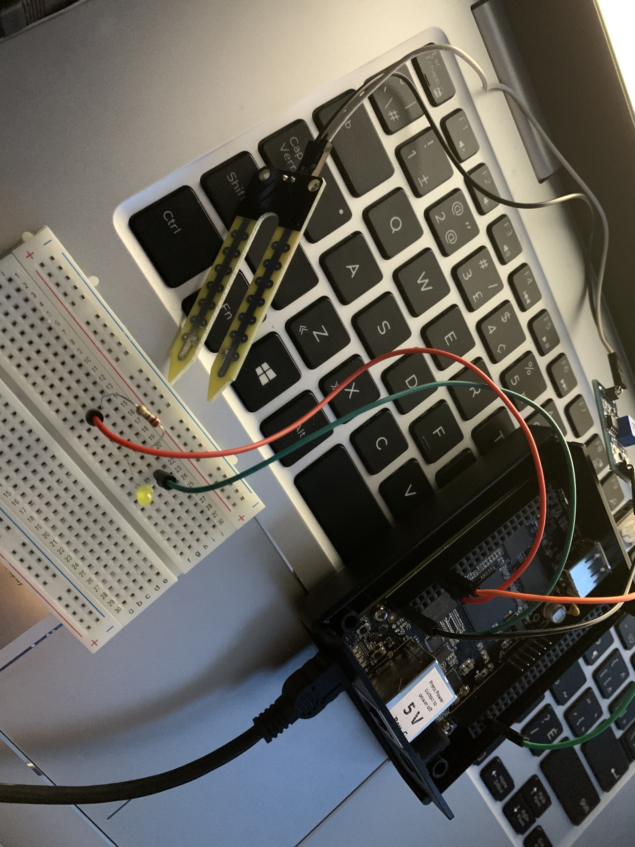
Connection
To connect the soil moisture sensor FC-28 in the digital mode, we will connect the digital output of the sensor to the digital GPIO pin of the BBB. The sensor module contains a potentiometer, which is used to set the threshold value.
The threshold value is then compared with the sensor output value using the LM393 comparator, which is placed on the sensor module.

Slide 14
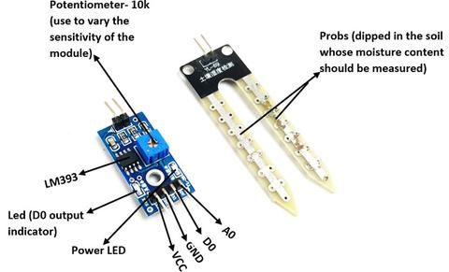
Cont…
The LM393 comparator compares the sensor output value and the threshold value, and then gives us the output through the digital pin.

Slide 15
Cont..
When the sensor value is greater than the threshold value, the digital pin will give us 5V, and the LED on the sensor will light up.
When the sensor value will be less than this threshold value, the digital pin will give us 0V and the light will go down.

Slide 16
Cont..
The first step is hooking the sensor up to the small board it comes with. On the sensor that goes into the soil you will see two pins.
The board has two sets of pins, the 4 pin set is what you connect to your beagle bone and the other set is the 2 pins you connect the sensor to.

Slide 17
Cont..
Next you will need to connect the unit to your beagle bone.
The sensor requires three things, the VCC ,ground and the Digital pin to read the sensor.

Slide 18
The vcc of the sensor is connected to the 5th pin of the p9 header.
The ground is connected to the pin 2 of p8 header.
The D0 pin of fc-28 is connected to the 12th pin(GPIO 44) of p8 header.
Also we have connected an led to the GPIO 26 (14th pin) of the beagle bone via a resistor.

Slide 19
If the sensor reads 0 it means the soil is moist. On the other end if it reads 1 your soil is dry.
The level of moisture that triggers the sensors reading 0 can be adjusted using the small potentiometer on the board.

Slide 20
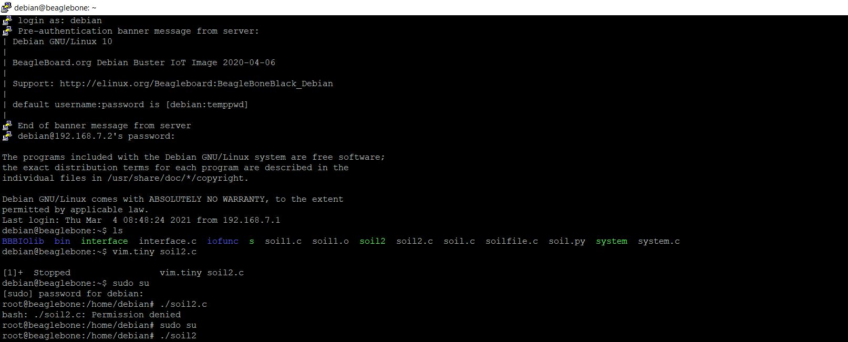
Code:

Slide 21
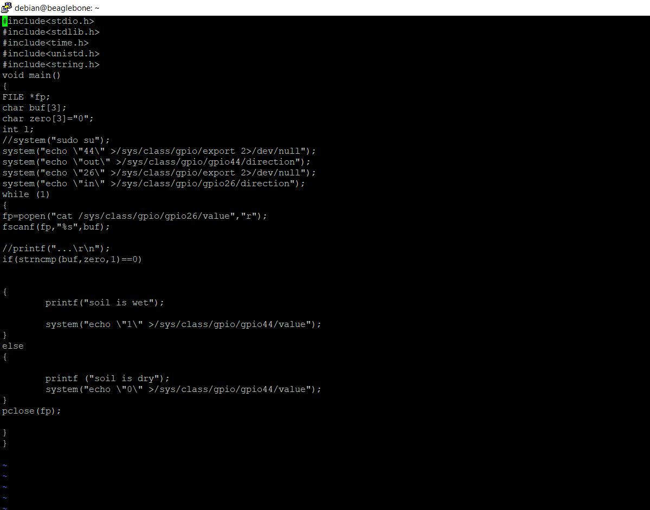
Cont..

Slide 22
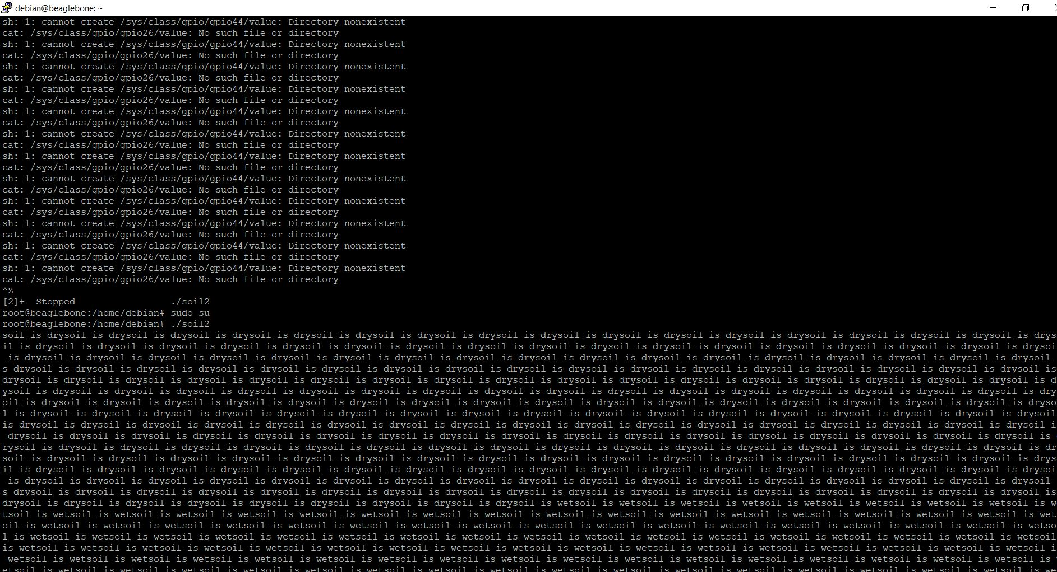
Output

Slide 23
Stdio.h and stdlib.h
These are two important header files used in C programming. While “<stdio.h>” is header file for Standard Input Output, “<stdlib.h>” is header file for Standard Library.
One easy way to differentiate these two header files is that “<stdio.h>” contains declaration of printf() and scanf() while “<stdlib.h>” contains declaration of malloc() and free().

Slide 24
Iolib libraries:
The great advantage of IOLib is, that it provides an unified interface to different types of streams.
It doesn't matter what type of stream you intend to access, the interface is always the same.
Another important point is that IOLib is compatible with many different operating systems

Slide 25
Cont…
The implementations are available in different programming languages (currently in C, C++, Objective C).
Furthermore, if you are using IOLib you don't have to care about the byte order in your binary files anymore.
IOLib supports Intel, Motorola (Raw) and VAX byte order and automatically adjusts to the host machine.

Slide 26
Cont…
A new feature of IOLib 2.0 was the capability of filtering your data before writing it to a file.
The filter support has been improved in the 4.x series. The API now supports compression/decompression filters and filters that have to process a file in one step.

Slide 27
Popen function
To launch and run another program from within your code, use the system() function. When your code must examine or save that program’s output, use the popen() function.
The popen() function uses a program name as its first argument. The second argument is a file mode. Such as r to read ,w for write or r+ for both.

Slide 28
Strncmp function
It is used for comparing two strings.
For example strncmp(str1, str2, 4) would compare only the first four characters of strings str1 and str2.
str1 – First String str2 – Second String n – number of characters that needs to be compared

Slide 29
Cont..
This function compares only the first n (specified number of) characters of strings and returns following value based on the comparison.
0, if both the strings str1 and str2 are equal
>0, if the ASCII value of first unmatched character of str1 is greater than str2
<0, if the ASCII value of first unmatched character of str1 is less than str2

Slide 30
References
Beagle bone black: https://beagleboard.org/black
Soil moisture sensor: https://maker.pro/arduino/projects/arduino-soil-moisture-sensor
Iolib library: http://www.iolib.org/docs/iolib.html

Slide 31
Adding the libraries: https://www.element14.com/community/community/designcenter/single-board-computers/next-genbeaglebone/blog/2013/10/10/bbb--beaglebone-black-io-library-for-c

Slide 32
Libraries: https://www.geeksforgeeks.org/whats-difference-between-and/
String: https://beginnersbook.com/2017/11/c-strncmp-function/

Slide 33
Thank you!!!!

